Slide 1


vakhta.xyz
Time records and an organized shift
Know who is working, what was handed over and whether equipment is ready.
Serhii, mechanic
Test bench serviced. Awaiting review
For manufacturers working in shifts
01 / 20
Notes:
Vakhta supports daily manufacturing work: orders and stages, output and quality, schedules and skills, time tracking, maintenance and salary records. Workers use Telegram; managers use the web panel.
Footage: Pexels 3195703.
https://vakhta.xyz/

Slide 2
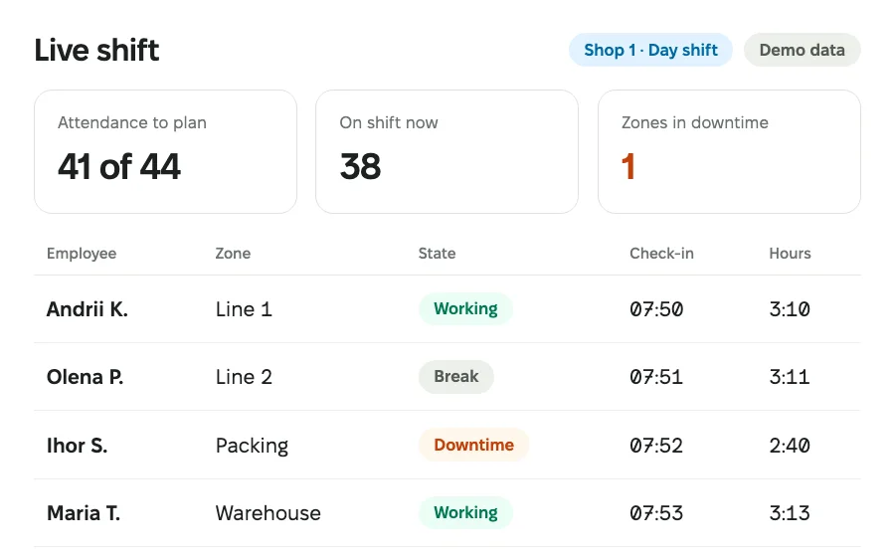
vakhta.xyz
Who is already working this shift?
Clock in by QR or Telegram
Work states and recorded time
Action history and shift completion
Live shift
Interface illustration with fictional data. The real interface evolves and may differ.
Without a required checklist: end in Telegram. With one: submit the report, then scan the exit QR.
02 / 20
Notes:
Who is already working this shift?
Live shift
Record arrival, work states and shift closure. Supervisors see current status, history and transfers between workplaces.
Find a worker and review status and recorded time.
A supervisor takes an authorized action with a comment or records a transfer.
Without a required checklist, finish through Telegram; with one, submit the report then use the exit QR.
Less searching through messages, more context for decisions.
https://vakhta.xyz/en/features/operations/
Interface illustration with fictional data. The real interface evolves and may differ.

Slide 3
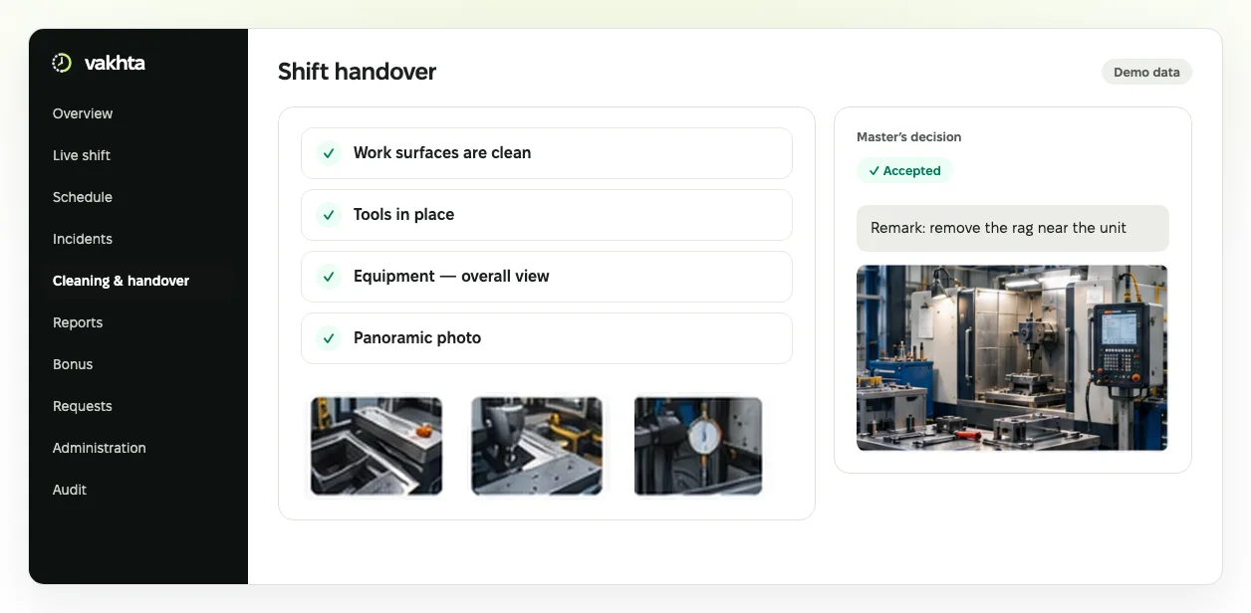
vakhta.xyz
The next shift accepts a documented zone
Checks and photos for each position
Reports and supervisor remarks together
Acceptance with handover history
Checklists + Checklist builder
Interface illustration with fictional data. The real interface evolves and may differ.
Checklist obligations are pinned to the shift; the supervisor decides on the report.
03 / 20
Notes:
The next shift accepts a documented zone
Checklists
For a shift with a required checklist, the worker prepares the zone, completes items and adds photos. A supervisor reviews the material and the next worker accepts the zone.
Workers complete their position’s checklist and submit photos.
The supervisor approves the report or records a specific concern.
The next shift reviews the handover and records acceptance.
Keep the zone’s condition, concerns and decisions together between shifts.
https://vakhta.xyz/en/features/handover/
Checklist builder
Define checks for each position: items, required photos and photo rules. Versions preserve the context of earlier reports.
Define what to check and photograph.
Assign the checklist to a position.
Workers follow it step by step in the bot.
Turn written standards into concrete actions.
https://vakhta.xyz/en/features/checklists/
Interface illustration with fictional data. The real interface evolves and may differ.

Slide 4
vakhta.xyz
Maintenance is done. Who accepts it?
Planned or emergency work
Service · Packaging line
Replace filter
Today · 14:00
Mechanics submit results in Telegram
Mechanic · Serhii M.
Work submitted for review
A responsible person reviews and decides
Return to service requires approval
Equipment and maintenance
Interface illustration with fictional data. The real interface evolves and may differ.
A mechanic’s submission does not replace review or the release decision.
04 / 20
Notes:
Maintenance is done. Who accepts it?
Equipment and maintenance
Planned maintenance is due, or equipment needs emergency work. Assign a person, provide instructions and review the result before release.
Register equipment and instructions, then publish its maintenance plan.
Assign planned or emergency work, a person and materials.
The mechanic records the result through Telegram.
A responsible person reviews completion and decides equipment release.
Know the next service date and who owns the work. A mechanic’s submission does not replace an authorized person’s decision.
https://vakhta.xyz/en/features/maintenance/
Interface illustration with fictional data. The real interface evolves and may differ.

Slide 5
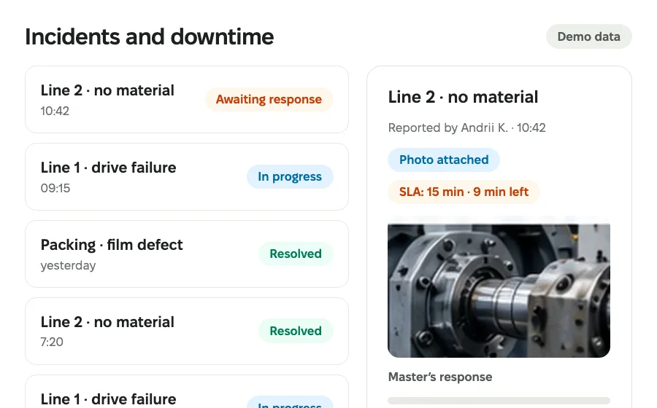
vakhta.xyz
The line stopped. Who is responding?
Reason, time and shop-floor photos
An owner and escalation rules
Response history and outcome
Downtime & incidents
Interface illustration with fictional data. The real interface evolves and may differ.
Recorded reasons and responses provide context for reviewing recurring problems.
05 / 20
Notes:
The line stopped. Who is responding?
Downtime & incidents
Workers report an obstacle in the bot. Supervisors see its reason, time, status and response history.
A worker selects a reason and adds details or a photo.
The responsible person is notified; overdue responses follow escalation rules.
The supervisor records the response and outcome.
See who is responding and what has been done. Recurring reasons stay in the record.
https://vakhta.xyz/en/features/incidents/
Interface illustration with fictional data. The real interface evolves and may differ.

Slide 6
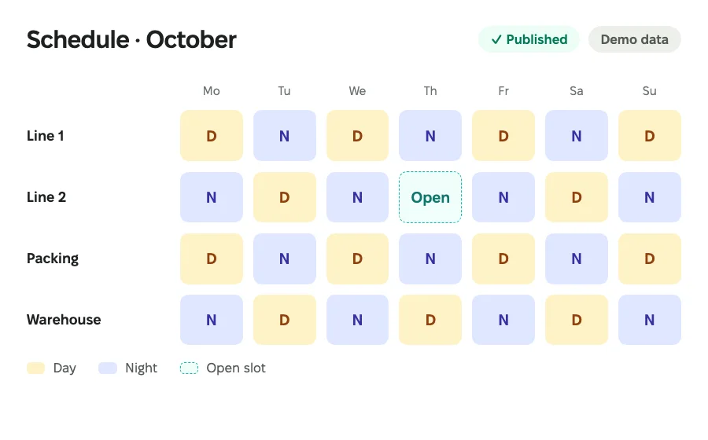
vakhta.xyz
Someone cannot work tomorrow’s shift
An absence request and an open slot
Availability, skills and work offers
Agreed staffing and a published plan
Scheduling + Employee requests
Interface illustration with fictional data. The real interface evolves and may differ.
A plan does not record attendance. Skill matching does not authorize work.
06 / 20
Notes:
Someone cannot work tomorrow’s shift
Scheduling
A shift has an open slot. Check availability, skills and coverage, offer the work and select someone for the plan.
Choose a plan, period and zone; review absences.
Review demand, availability and candidate preparation.
Send an offer and decide the staffing.
Publish plan changes and notify workers.
Managers can review the basis for a replacement before work starts. A plan does not record attendance, and matching does not authorize work.
https://vakhta.xyz/en/features/schedule/
Employee requests
Workers submit Telegram requests, from absence or shift cover to corrections, appeals and suggestions. A responsible person records the decision; schedule effects depend on request type.
The worker chooses a type, period and reason.
A reviewer records a decision.
History shows who approved the request and when.
Keep approvals out of scattered personal conversations.
https://vakhta.xyz/en/features/requests/
Interface illustration with fictional data. The real interface evolves and may differ.

Slide 7
vakhta.xyz
Who is prepared for this work?
Skill level and validity
Skills · Shop 1
Line setup
Olena P.
Confirmation by a responsible person
Level 3
Valid until 30 Nov
Coverage for the unit’s work
Unit coverage
Skills
Interface illustration with fictional data. The real interface evolves and may differ.
A confirmed skill supports the manager’s decision; it is not automatic work authorization.
07 / 20
Notes:
Who is prepared for this work?
Skills
A worker is absent and the line needs someone with the right preparation. Review levels, validity and the unit’s recorded skill coverage.
Define skills and position requirements.
Review levels, validity and unit coverage.
Review an evidence-based skill confirmation request after work.
A manager selects the person and checks work permissions.
Managers can see the basis for selecting a person. A skills match grants neither access nor permission to perform the work.
https://vakhta.xyz/en/features/skills/
Interface illustration with fictional data. The real interface evolves and may differ.

Slide 8
vakhta.xyz
Another zone needs a person
An approved transfer during a shift
Transfer · current shift
Packing
Until 10:30
One workplace ends; another starts
Assembly
From 10:30
Time and pay terms retain their context
Supervisor recorded the reason
In-shift transfers
Interface illustration with fictional data. The real interface evolves and may differ.
Transfers need approval within one site; pinned pay terms remain in effect.
08 / 20
Notes:
Another zone needs a person
In-shift transfers
At 10:30 another zone needs a worker. A supervisor authorizes the transfer with a reason; recorded time stays with the place where the work happened.
Choose the worker, unit and zone within the same site.
End active production participation if present, and give the transfer reason.
An authorized supervisor confirms the action or approves the worker’s request.
Review the linked shift parts and meet the destination’s requirements.
You can reconstruct where and when the person worked. An in-shift transfer does not change their permanent personnel assignment.
https://vakhta.xyz/en/features/transfers/
Interface illustration with fictional data. The real interface evolves and may differ.

Slide 9
vakhta.xyz
Relevant actions in familiar Telegram
A menu for each specialization
Telegram · Mechanic
My work
Mechanics see work and instructions
Replace filter · Line 2
Instructions
Materials
Targeted messages without a shared chat
Submit result
Specialized Telegram + Communications
Interface illustration with fictional data. The real interface evolves and may differ.
Available actions depend on role, specialization and enabled capabilities.
09 / 20
Notes:
Relevant actions in familiar Telegram
Specialized Telegram
Configure available functions around the employee’s work. Mechanics, cleaners, economists and shop heads receive the relevant set of actions.
Select the specialization and available functions.
Review the bot interface in its contextual preview.
The employee uses permitted actions in the same Telegram bot.
People can find their own actions without searching through unrelated work. Permissions and each action’s prerequisites still apply.
https://vakhta.xyz/en/features/telegram/
Communications
Pick workers by unit or team and send each a private Telegram message with files or a short questionnaire. Information reaches the night shift too.
Find recipients by employee or unit.
Add text, attachments or questions.
Review dispatch in the sent list.
Reach workers through the channel they already use.
https://vakhta.xyz/en/features/communications/
Interface illustration with fictional data. The real interface evolves and may differ.

Slide 10
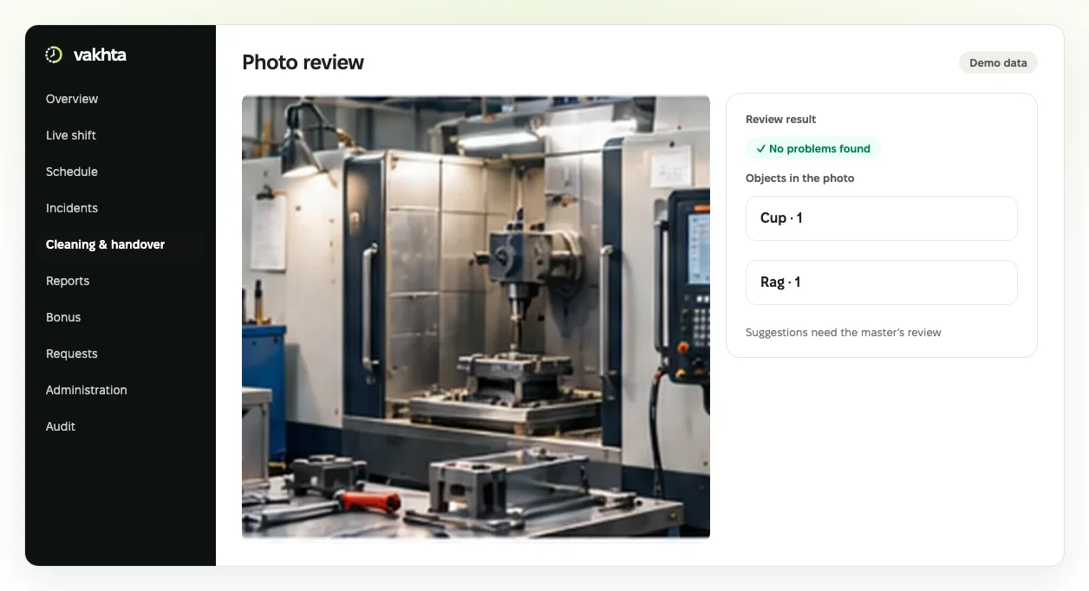
vakhta.xyz
A photo concern has a clear basis
Photos and rules beside the report
AI suggestions when the service is connected
The supervisor makes the final decision
Photo review
Interface illustration with fictional data. The real interface evolves and may differ.
AI offers suggestions; the supervisor reviews the material and decides.
10 / 20
Notes:
A photo concern has a clear basis
Photo review
Supervisors mark objects on cleaning-report photos and record a verdict for each, with AI only suggesting. Saved reviews settle disputes with evidence.
Find photos by period or review result.
Inspect the material and recorded observations.
Use it for consistent quality reviews.
Shared context for cleanliness reviews. The supervisor remains accountable for the decision.
https://vakhta.xyz/en/features/photos/
Interface illustration with fictional data. The real interface evolves and may differ.

Slide 11
vakhta.xyz
Workers can see where points come from
One point for a shift’s approved checklist
Points for approved work
Shift checklist
+1 point
A personal score in Telegram
Approved by supervisor
Worker’s history
Monthly point and remark history
Approved checklist · +1
Bonus
Interface illustration with fictional data. The real interface evolves and may differ.
An approved checklist earns one point per shift. Points are separate from salary.
11 / 20
Notes:
Workers can see where points come from
Bonus
Each checklist a supervisor approves earns the worker one point. Points and remarks are visible in the panel and Telegram, so the bonus basis is clear.
The supervisor reviews a report and records the decision.
Workers check their points in Telegram.
Managers review monthly totals and history.
A clear basis for discussing contributions. Points tracking is not payroll calculation.
https://vakhta.xyz/en/features/bonus/
Interface illustration with fictional data. The real interface evolves and may differ.

Slide 12
vakhta.xyz
From rate and hours to amount and balance
Accrual from pay terms and time
Salary · October
Approved rate
Amount due entered by accountant
Accountant-entered amount due
₴150 / hour × 160 hours
UAH 22,000
Rate calculation
Payment recorded
₴15,000
Recorded payments and remaining balance
₴24,000
Remaining
UAH 7,000
Salary
Interface illustration with fictional data. The real interface evolves and may differ.
Recording payment does not move funds. Accrual and the accountant’s amount due are distinct.
12 / 20
Notes:
From rate and hours to amount and balance
Salary
At month end, reconcile rates, recorded time and accruals. An accountant enters the amount due; a separate record retains the actual payment.
Approve rules, rates, supplements and their effective dates.
Review recorded time and incomplete calculation inputs.
With the required access, enter the amount due determined by the accountant.
Record an actual payment or correction and inspect the balance.
Reduce manual reconciliation between time records and payments. Vakhta does not transfer money, calculate statutory taxes or replace accounting.
https://vakhta.xyz/en/features/payroll/
Interface illustration with fictional data. The real interface evolves and may differ.

Slide 13
vakhta.xyz
A report differs. What is behind it?
Losses, people, money and completeness
Reports
Losses
People
Money
From a period to a worker or shift
12 h
42
UAH 24,000
Data completeness: missing evidence is separate
Records and available exports for review
From a period to a worker or shift
Reports
Interface illustration with fictional data. The real interface evolves and may differ.
Reports use recorded evidence; they do not measure OEE or prove root cause.
13 / 20
Notes:
A report differs. What is behind it?
Reports
Find a period’s discrepancy and open the unit, worker or shift records. Missing evidence needs investigation.
Choose a period and authorized scope.
Review losses, people, money or data completeness.
Open a drilldown and check the evidence.
Use the available export for review.
Decisions use recorded evidence. Production output and quality live in a separate module; time reports do not measure OEE.
https://vakhta.xyz/en/features/reports/
Interface illustration with fictional data. The real interface evolves and may differ.

Slide 14
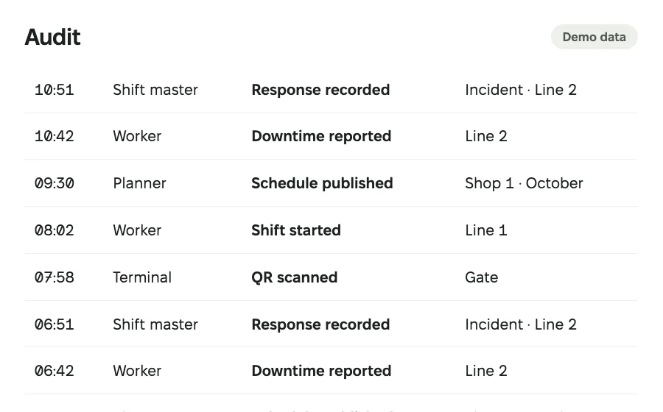
vakhta.xyz
Who changed the record, and why?
The actor and action time
The reason and changed values
Append-only audit history
Audit
Interface illustration with fictional data. The real interface evolves and may differ.
Audit history appends events rather than rewriting earlier records.
14 / 20
Notes:
Who changed the record, and why?
Audit
The log records panel and bot actions with author, time, reason and before-and-after values, so disputed events are rebuilt from records, not memory.
Filter by action or object.
Open a record’s details.
Compare values before and after the change.
Traceability for internal control and resolving disputed events.
https://vakhta.xyz/en/features/audit/
Interface illustration with fictional data. The real interface evolves and may differ.

Slide 15
vakhta.xyz
Start with your structure and people list
Import structure and people from XLSX / CSV
Import · team.xlsx
Columns mapped
Structure reviewed
Map and validate before saving
Employees reviewed
Preview
Units, positions and scoped permissions
Confirm import
Data import + People & setup
Interface illustration with fictional data. The real interface evolves and may differ.
Imports cover structure and people, not historical timesheets or payroll.
15 / 20
Notes:
Start with your structure and people list
Data import
Prepare your organization structure and employee list without entering every row again. Import shows the result before saving.
Upload a file for one site and select the effective date.
Map columns, review the structure and correct errors.
Confirm the reviewed import.
Start from an existing spreadsheet. This imports structure and personnel, not historical time records or payroll, and is not live ERP synchronization.
https://vakhta.xyz/en/features/imports/
People & setup
Describe plants, units, zones and positions, import workers and grant roles with scoped access. Everyone sees only the part of production they run.
Add workers or import a list.
Configure the structure and relevant roles.
Link Telegram and connect terminals.
One structure for schedules, attendance and operational processes.
https://vakhta.xyz/en/features/administration/
Interface illustration with fictional data. The real interface evolves and may differ.

Slide 16
vakhta.xyz
An unfamiliar step need not stop work
Instructions and available walkthroughs
Learning Center
Help · AI
How do I publish a schedule?
How do I change the active plan?
An in-panel documentation assistant
1. Select a plan
Open the schedule and select a plan.
2. Review changes
Guidance based on documentation
People confirm operational actions themselves
3. Publish
Common answers
Learning Center + AI documentation help
Interface illustration with fictional data. The real interface evolves and may differ.
AI explains documentation; it does not inspect company records or change data.
16 / 20
Notes:
An unfamiliar step need not stop work
Learning Center
Instructions, available walkthroughs and update history live in the panel. The Learning Center shows materials for your role and enabled capabilities.
Find the instructions for your task.
Open an available step-by-step walkthrough.
Choose records and confirm work changes yourself.
Guidance explains the next step. Finishing a walkthrough records learning progress; it does not perform business actions for you.
https://vakhta.xyz/en/features/learning/
AI documentation help
Open the panel’s documentation assistant for reviewed common answers and procedural explanations based on documentation.
Open the assistant beside the task; on a phone, use the sidebar.
Choose a common answer or ask a documentation question.
Use the explanation and perform the action yourself.
AI explains procedures; it cannot inspect company records or change data. Generated answers require a configured AI service.
https://vakhta.xyz/en/features/support/
Interface illustration with fictional data. The real interface evolves and may differ.

Slide 17
vakhta.xyz
From order to accepted output
Orders, routes and stage work
Production · Department 1
Order #024 · 500 pcs
People’s participation and recorded output
1 Cutting
2 Assembly
3 Packing
Stage output: cutting
Good
480 pcs
Quality and rework decisions
Scrap
10 pcs
Awaiting review
10 pcs
Production
Interface illustration with fictional data. The real interface evolves and may differ.
Stage output is a separate record. Quality, rework and release require decisions.
17 / 20
Notes:
From order to accepted output
Production
See which stage an order has reached and what needs a decision. Record crew work, stage output, scrap and quantities awaiting review.
Save customer demand and transfer selected lines into production.
Define routes and stages for department work.
Record actual worker participation at the stage.
Record good output, scrap and quantities awaiting review.
Decide quality outcomes or authorize linked rework.
Managers can follow order progress and the basis for decisions. One stage’s output does not mean the entire customer order is fulfilled.
https://vakhta.xyz/en/features/production/
Interface illustration with fictional data. The real interface evolves and may differ.

Slide 18
vakhta.xyz
A proposal for your modules and team
An individual proposal
1 month free
Modules
Team
The capabilities your company needs.
The number of people who will use Vakhta.
Your team uses the modules agreed for the pilot.
We provide commercial proposals in USD.
Paid continuation starts only after separate agreement.
Standard setup and initial team training are included in the agreed proposal.
18 / 20
Notes:
An individual proposal for your company
Paid continuation starts only after separate agreement.
Standard setup and initial team training are included in the agreed proposal.

Slide 19
vakhta.xyz
Launch starts with prepared data
Today
Within 3 days
In 30 days
Demo
Setup
Trial month
Review your shop-floor workflow.
Import data and agree on setup.
Use the modules agreed for your pilot.
Launch within 3 days
For teams of up to 100 people, after we receive all required data. Appoint one person on your side to prepare the data and approve setup.
We respond around the clock, 24/7.
support@vakhta.xyz
19 / 20

Slide 20

vakhta.xyz
See Vakhta with your workflow in 30 minutes
Discuss your process and the next step
cal.com/vakhta/demo
sales@vakhta.xyz
vakhta.xyz
20 / 20
Notes:
Book a 30-minute demo: we will show Vakhta using your shop floor as an example and agree on a trial month.
https://cal.com/vakhta/demo?utm_source=vakhta.xyz&utm_medium=referral&utm_campaign=demo&utm_content=en_presentation
sales@vakhta.xyz
Fixel fonts by MacPaw and AlfaBravo, SIL Open Font License.

